Slide 1
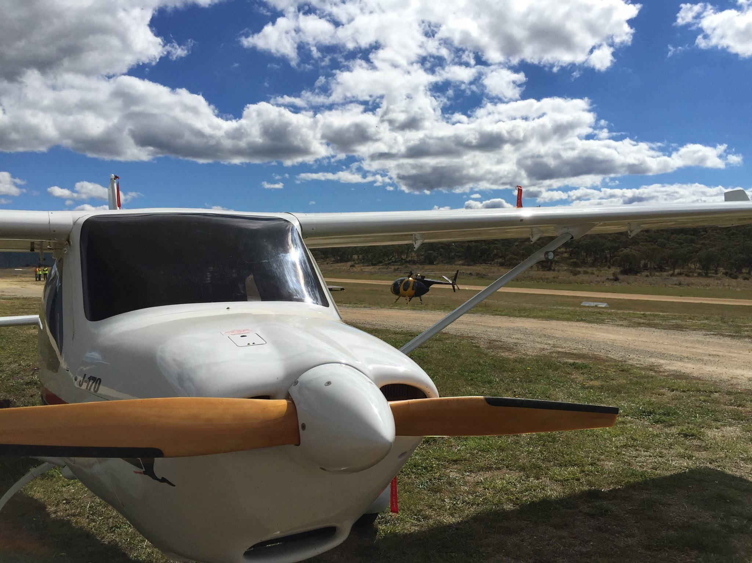

Slide 2
Stalling – 3 Axis

Slide 3
AIM
To identify the situations where the aircraft is likely to stall and recognise pre-stall symptoms. When stalled adopt the appropriate recovery actions for minimum height loss.

Slide 4
APPLICATION
Any phase of flight where critical A of A is exceeded

Slide 5
UNDERPINNING THEORY

Slide 6
L = Angle of Attack x Airspeed
Smooth airflow over the wing breaks down and becomes turbulent
Breaks away from upper surface, aircraft sinks, nose pitches down

Slide 7
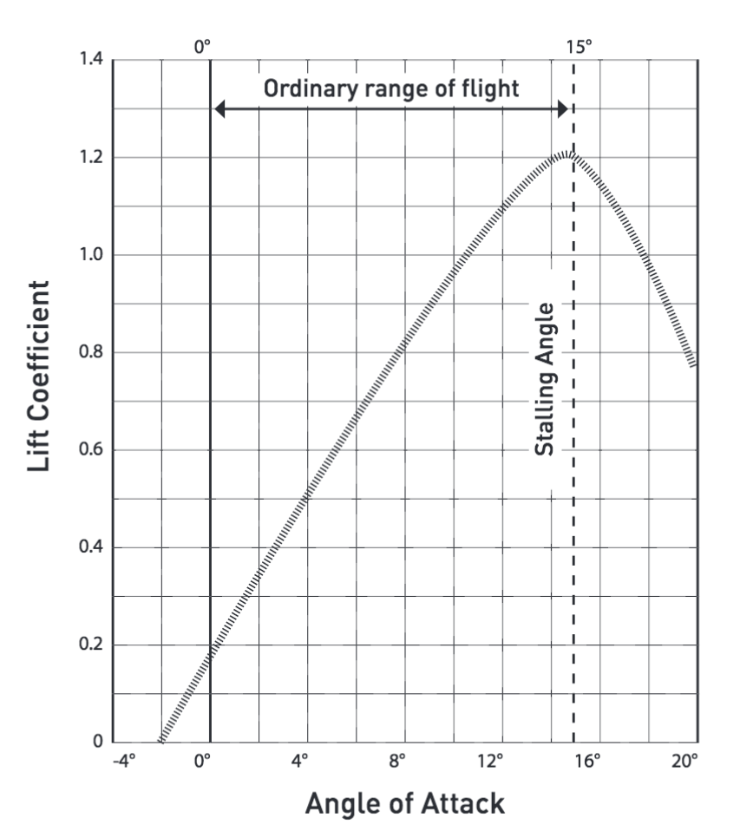
At the stall
When the wing stalls there is a ↓ in L and a large ↑ in D
Aircraft sinks, C of P moves rearwards → pitch down
Stalls result from exceeding critical Angle of Attack
The elevator controls the A of A of wing
Lift/Drag curve
Airspeeds are referenced in POH in relation to stalling
Stall Speed increase in turning flight due to increased “loading”

Slide 8
FLIGHT EXERCISE

Slide 9
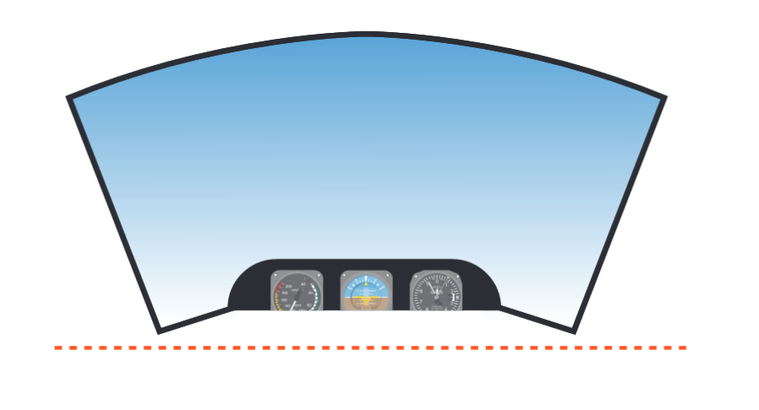
Entry
HASELL check (Minimum height I.A.W. RAAus Operations Manual)
Adopt slow flight to identify symptoms and reduced control
Recognition of the stall point in various configurations
Practice and develop recovery actions for min height loss in stall including any ‘incipient’ rotation
Demonstration and understanding of developing conditions due to mishandling of controls or lack of recognition
Practice and recognition of pre-stall scenarios and appropriate actions
Carb heat HOT
Close throttle
Keep straight with rudder
Maintain altitude with backpressure

Slide 10
Symptoms
Low and decreasing airspeed
Possible high nose altitude
Less effective controls – higher stick forces
Stall warning – if fitted
Buffet (turbulent air from wing striking tailplane)
Control column will be fully back – no further control movement, past stall stick position
High sink rate often undetected

Slide 11
At the stall
Aircraft sinks and nose pitches down
If aircraft yaws/rolls correct with opposite rudder only - do not use ailerons

Slide 12
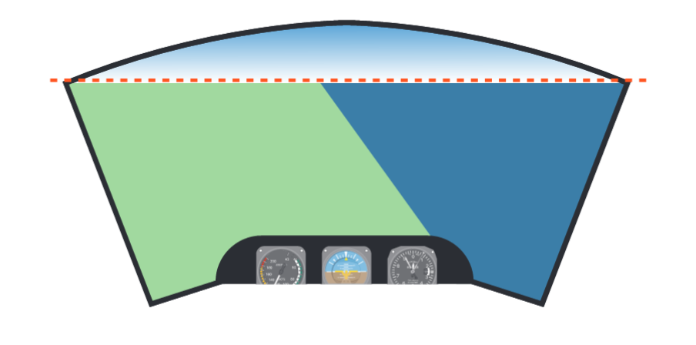
Recovery
Unstall Wing
Check forward with control column to reduce angle of attack
Do not use ailerons, maintain heading with rudder only
Aeroplane will descend
Recover to S+L with PAT
To Minimise Height Loss – max of 100 ft
Power + Attitude + Performance
Unstall, as above, check forward
Apply full power – balance with rudder
Raise nose to the horizon to reduce sink
Lowering attitude assists acceleration
Regain height and S+L

Slide 13
Recovery at Onset
Normal situation
Recover at stall warning/buffet
Height loss – 50 ft maximum

Slide 14
AIRMANSHIP AND HUMAN FACTORS
✓
Lookout - Situational Awareness SA
✓
Counterintuitive responses and fear TEM
✓
Mismanagement and distraction SA
✓
Recognition of loss of primary control functions
✓
Limitations in identifying sink rate (Vestibular)
✓
Adherence to personal minimums and airspeed management

Slide 15
OUTCOMES & EXPECTATIONS
Define the stalled condition
Developed recognition of all pre-stall symptoms in flight
Pilot can state likely scenarios where stalling may occur
Apply timely and appropriate corrective actions
Required recovery standard: Height loss <200 ft, Heading maintenance +/- 10 degrees, Airspeed within Va/Vfe

Slide 16
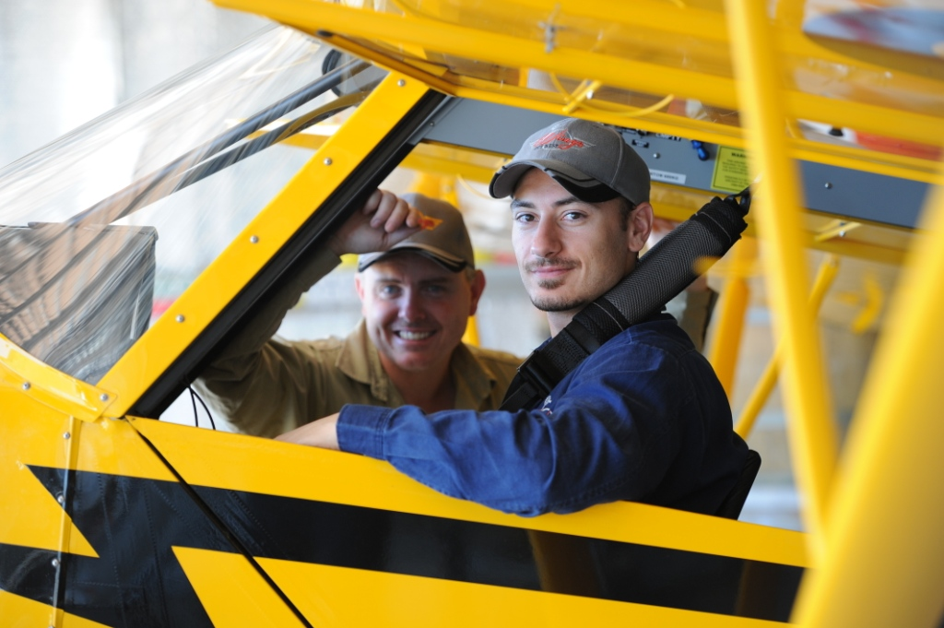
QUESTIONS?

Slide 17
www.raa.asn.au

