Slide 2
Pre-flight Inspection

Slide 3
AIM
To determine the airworthiness of the aircraft for flight based on regulatory and operational requirements.

Slide 4
APPLICATION
Before first flight of the day and any command flight

Slide 5
UNDERPINNING THEORY

Slide 6
Aim: The pre-flight inspection is a mandatory function to be carried out by the command pilot in order to determine the airworthiness of the aircraft for the intended flight. The aircraft POH is the reference document or the RAAus Technical Manual if no POH exists.

Slide 7
Each inspection element can be assessed using a short acronym of 3 C’s:
Correct operation and assembly
Condition determined as airworthy
Change in condition or integrity from known standard
CAR 1998 Schedule 5
CAR 42B and CAAP
Aeroplane Flight & Maintenance Manuals
RAAus Operations and Technical Manuals

Slide 8
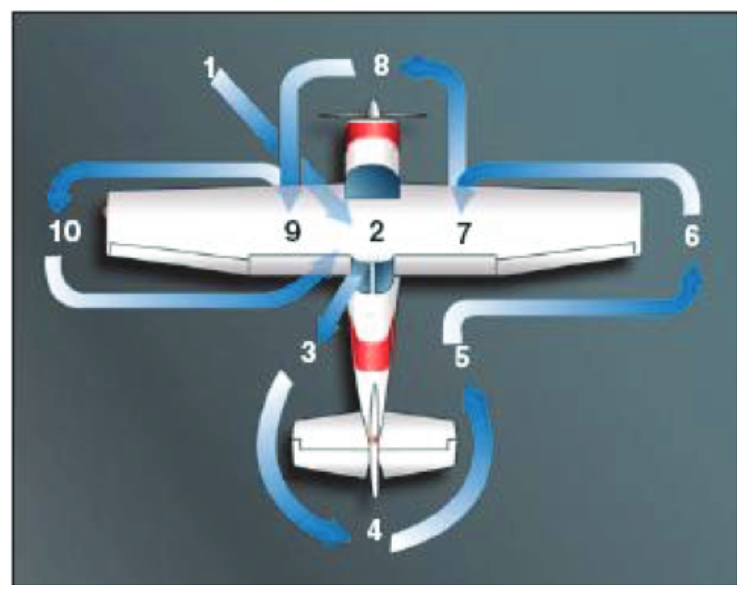
Pre-flight should follow a consistent flow process, example above from aircraft POH

Slide 9
FLIGHT EXERCISE

Slide 10
Review POH, Maintenance record and flight authorisation sheets
Determine administrative compliance to fly via MR and RAAus requirements
Ensure the aircraft is secured in suitable place for inspection/refueling
Determine in what sequence fueling or pre-flight is to take place

Slide 11
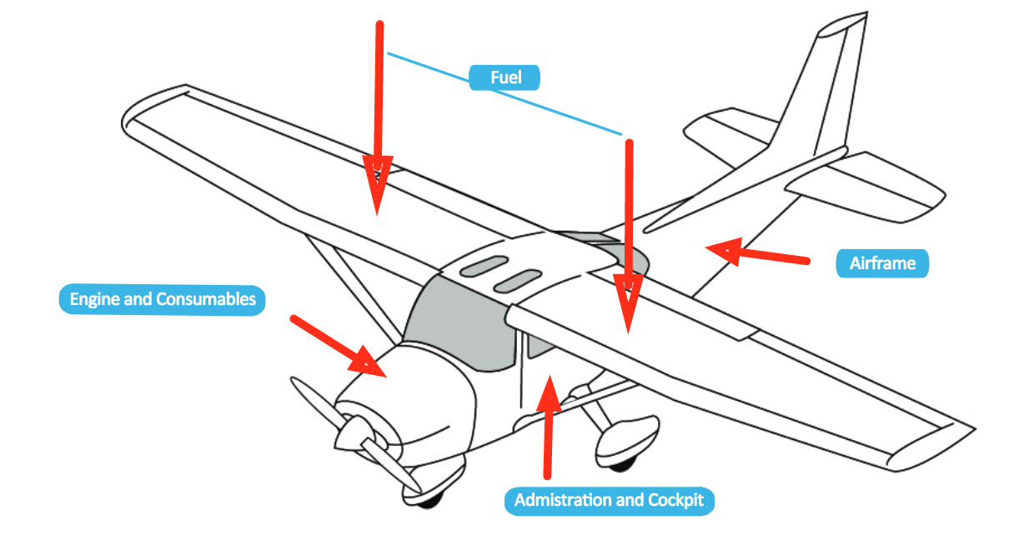
General Sequence Is;
A: Administration: Appropriate aircraft documents check, maintenance record, flight record, registration, known AD’s and SB’s
C: Cockpit: Remove locks, confirm switches OFF
E: Engine & Consumables: Fuel, Oil, coolants hydraulics etc. Fuel checked for quantity, colour, contamination, clarity and odour
A: Airframe: Metal composites, and fabric all have different unique requirements for checking
A: Authorisation: Complete any Administration required

Slide 12
AIRMANSHIP AND HUMAN FACTORS
✓
Assume something is wrong with the aircraft (T.E.M.)
✓
Focus on task without distractions (S.A.)
✓
Seek assistance or confirmation if required (A.D.M.)
✓
Perform inspection methodically and consistently (T.E.M.)
✓
Familiarise with aircraft type and know watch items (C.R.M.)

Slide 13
OUTCOMES & EXPECTATIONS
Pilot understands LM, L1, CAR Schedule 5,8 privileges
Understands and identifies all appropriate systems pertinent to aeroplane
Pilot can determine and confirm aircraft serviceability including W&B for flight

Slide 14
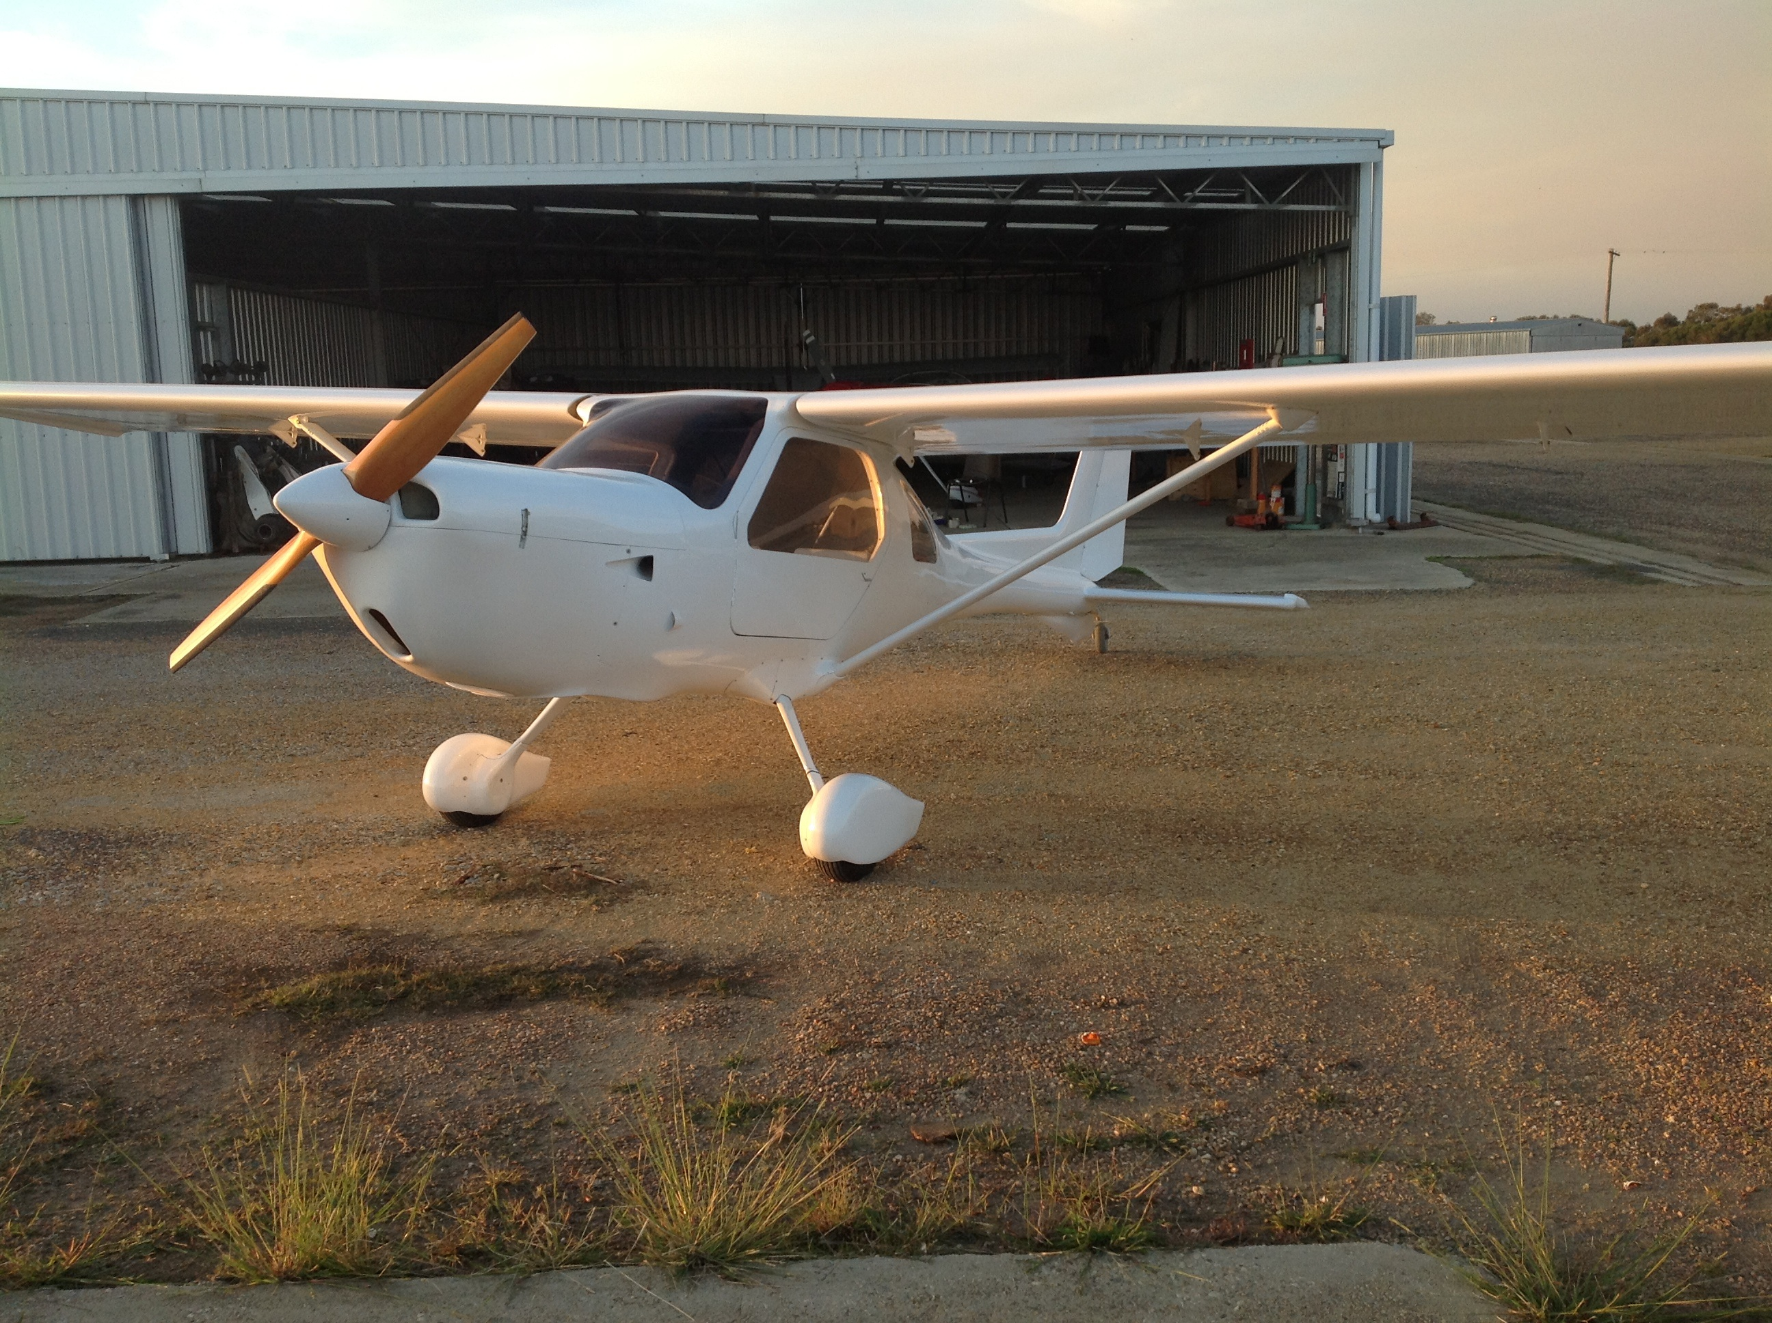
QUESTIONS?

Slide 15
www.raa.asn.au

