Slide 1
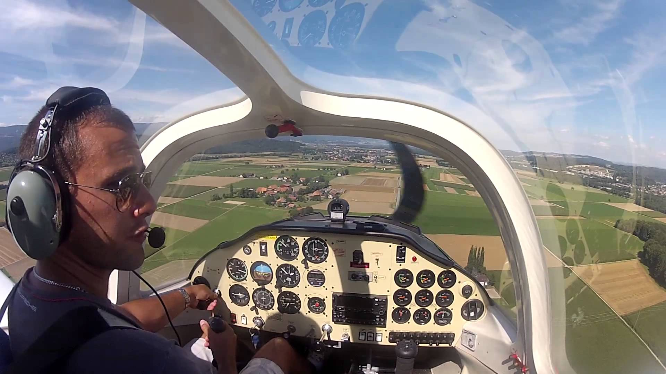

Slide 2
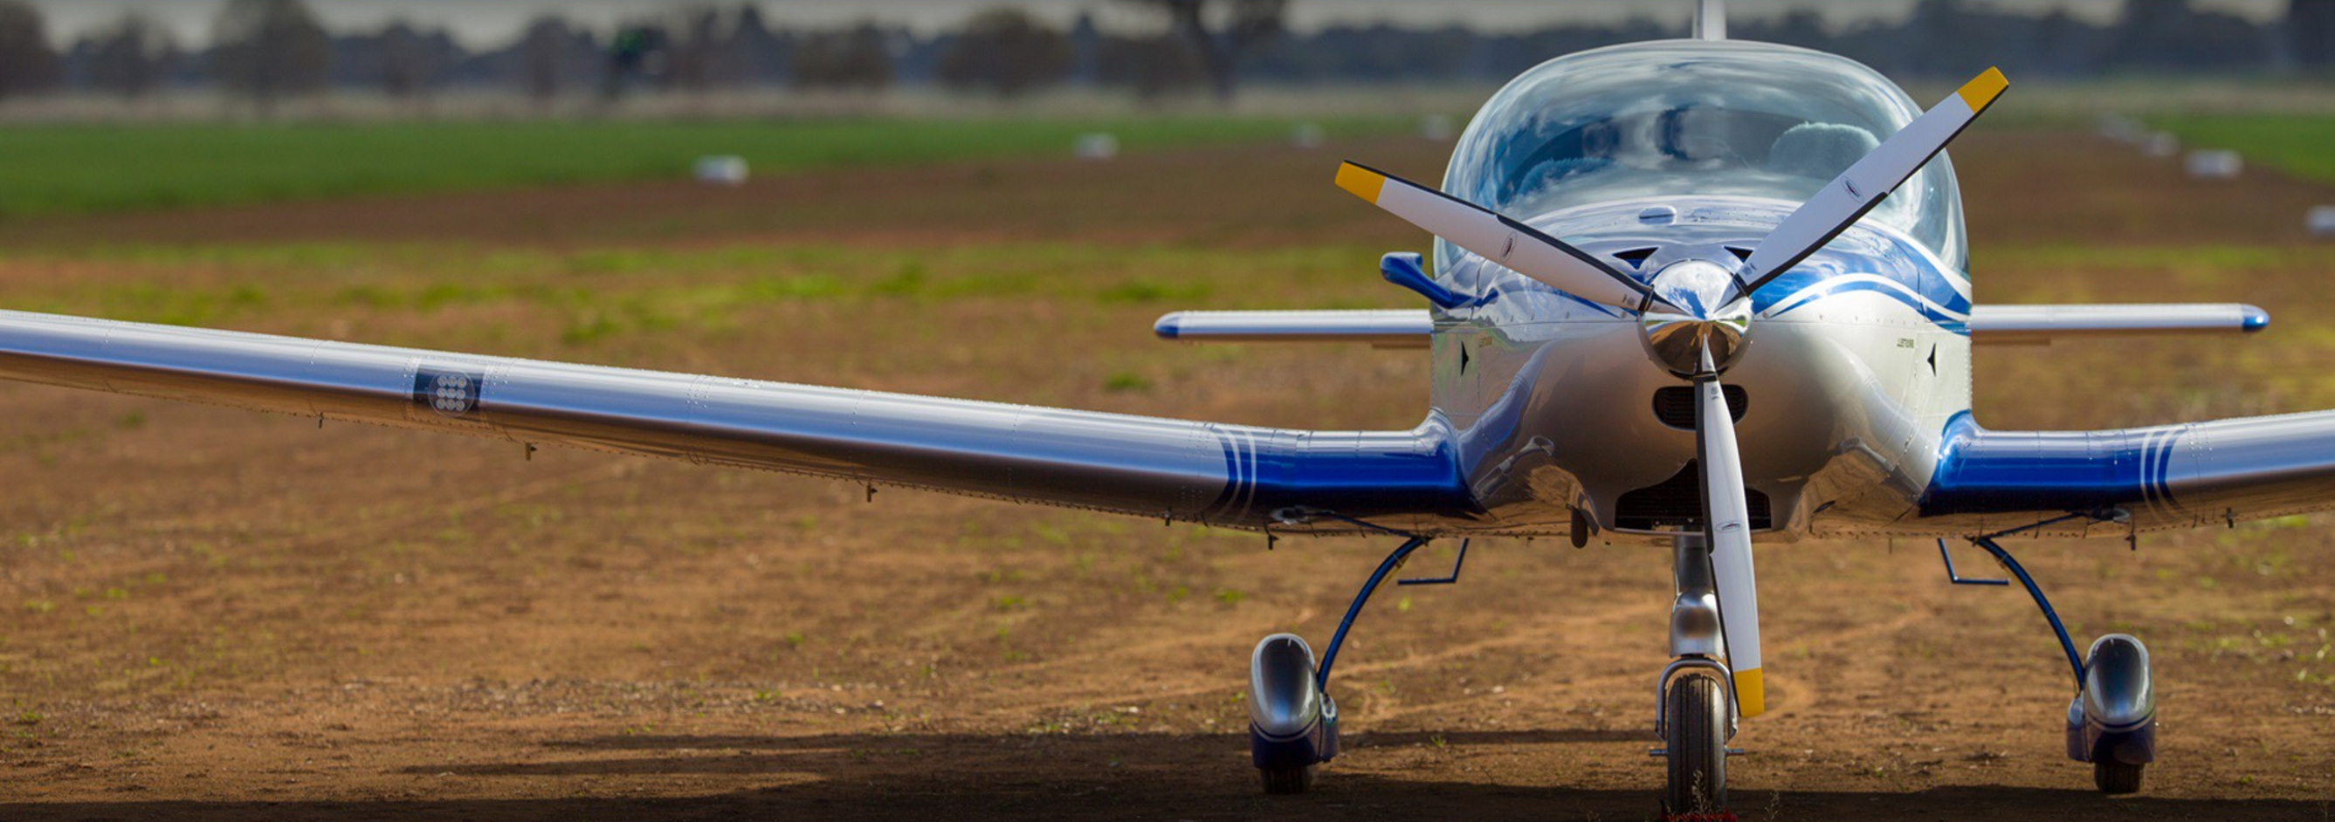
Effects Of Controls – 3 Axis

Slide 3
AIM
To operate the primary and ancillary controls in flight and on the ground and feel and understand the primary, secondary, and further effects they have on the aircraft.

Slide 4
APPLICATION
Control grip & feel
Visual flight focus outside cockpit
Cockpit layout/adjustments
Introduction of pre/post flight actions
Demonstrate/practice sequence

Slide 5
UNDERPINNING THEORY

Slide 6
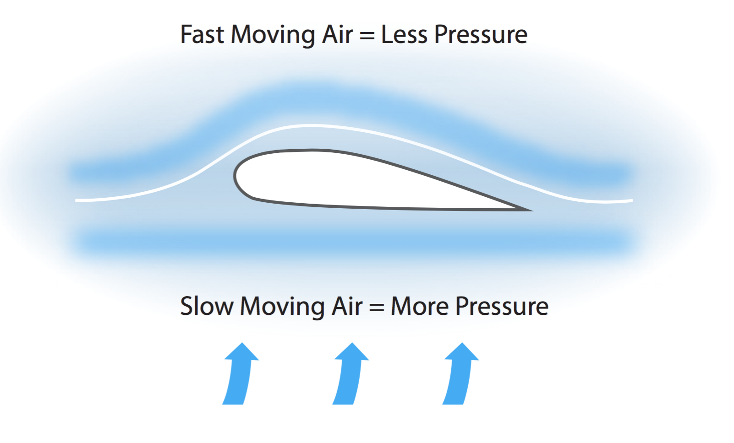
Lift
As air flows over the wing, increased speed above the wing results in reduced pressure = Lift
Lift can be altered by changing the shape of the wing, the angle of attack, and the airspeed

Slide 7
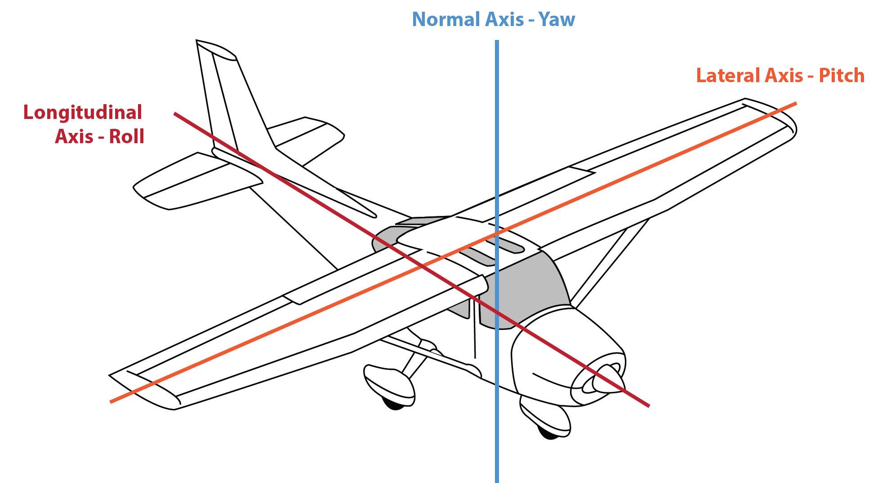
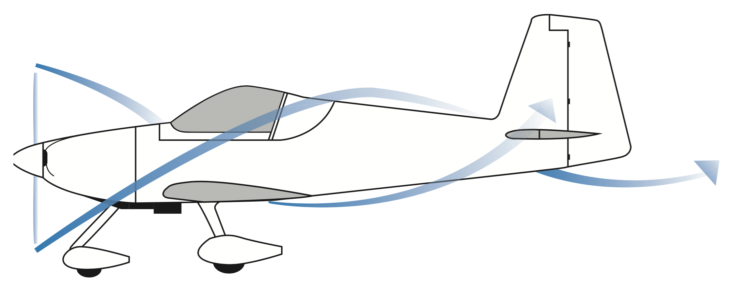
Primary Controls
Elevator pitches aeroplane – changing attitude
Aileron rolls aeroplane – changing direction
Rudder yaws aeroplane – balanced flight
Slipstream affects the rudder and elevator

Slide 8
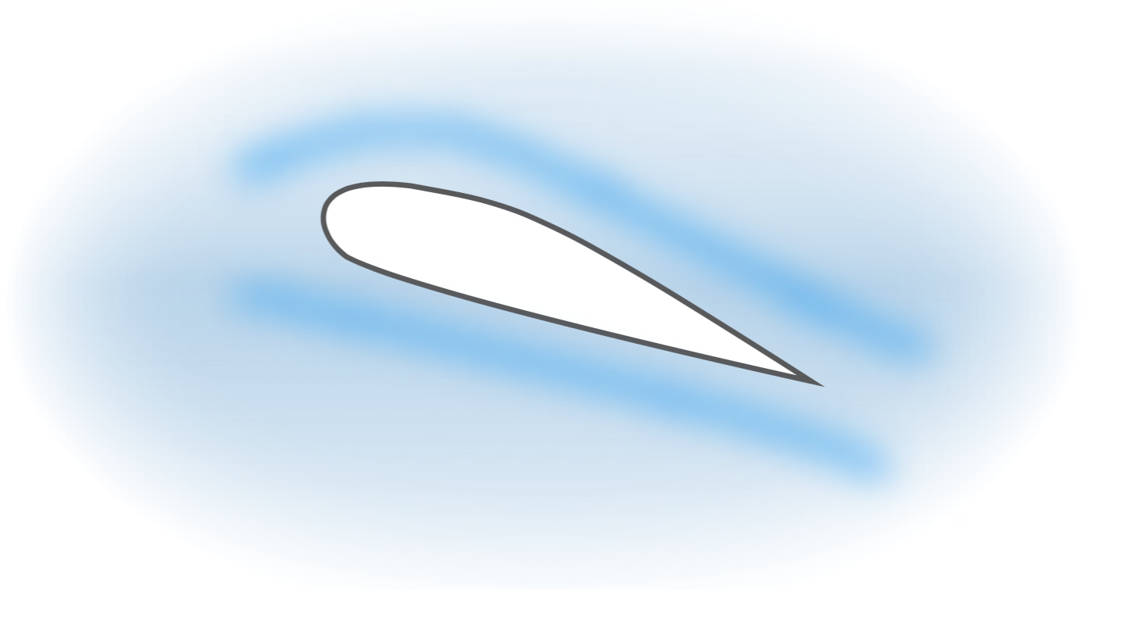
Ancillary Controls
Trim tabs provide a force to hold primary controls
Flap changes shape of wing, increases lift, drag, and L/D ratio – changes pitch-trim change required
Carburettor heat assists in preventing and reducing icing in the fuel delivery system

Slide 9
FLIGHT EXERCISE

Slide 10
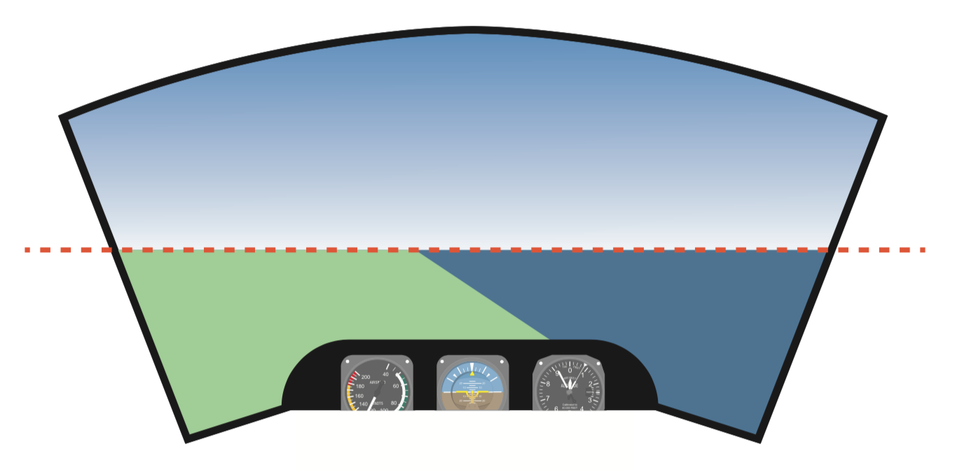
ON THE GROUND
Control speed with throttle and brakes
One hand on control column and other on throttle
Dual controls fitted
Power – controls movement
Brakes – control slowing/stop
Pedals – control steering

Slide 11
IN THE AIR
Attitude flying is achieved by referencing nose and wings to the horizon
Axis | Control | Input |  | Primary Effect |  | Secondary/Further | Use
Lateral | Elevator | Control Column | forward rearward | Pitch | down up | - | Attitude and Airspeed
Longitudinal | Aileron | Control Column | right left | Roll | right left | Slip - Yaw | Direction
Normal | Rudder | Rudder Pedals | left right | Yaw | left right | Skid - Roll | Balance

Slide 12
Airspeed
Increased airspeed – firmer control feel & response rate, less movement needed
Decreased airspeed – reduced control feel & response rate, more movement needed
Slipstream
Increased power → increased slipstream
Increased flow over elevator → more effective control
Affects vertical surfaces → yaw
Effect balanced with rudder

Slide 13
Power
Power decrease → nose pitches down/yaws right
Power increase → nose pitches up/yaws left
Must balance with rudder
Trim
To relieve the pressure
If holding back pressure – trim backwards
If holding forward pressure – trim forwards

Slide 14
Flap
Extending flap → increase in lift and drag → pitch change – trim change required
Retracting flap → decrease in lift and drag → pitch change – aircraft will sink

Slide 15
AIRMANSHIP AND HUMAN FACTORS
✓
Limitations of memory
Control handover process – CRM “I have control/you have control”, “follow me through”
✓
More comfortable with practice/workload
✓
✓
VFR – see and be seen
✓
Clock code, relative height/distance
✓
Uncoordinated lesson by nature
✓
Horizon is main reference
Demonstration/practice process - CRM
✓
✓
Land features
✓
Limitations on lookout – S.A.
✓
Self assessment – I.M.S.A.F.E

Slide 16
OUTCOMES & EXPECTATIONS
Student identifies and understands control and responses
Can identify and reference the horizon correctly
Is comfortable in the airborne environment

Slide 17
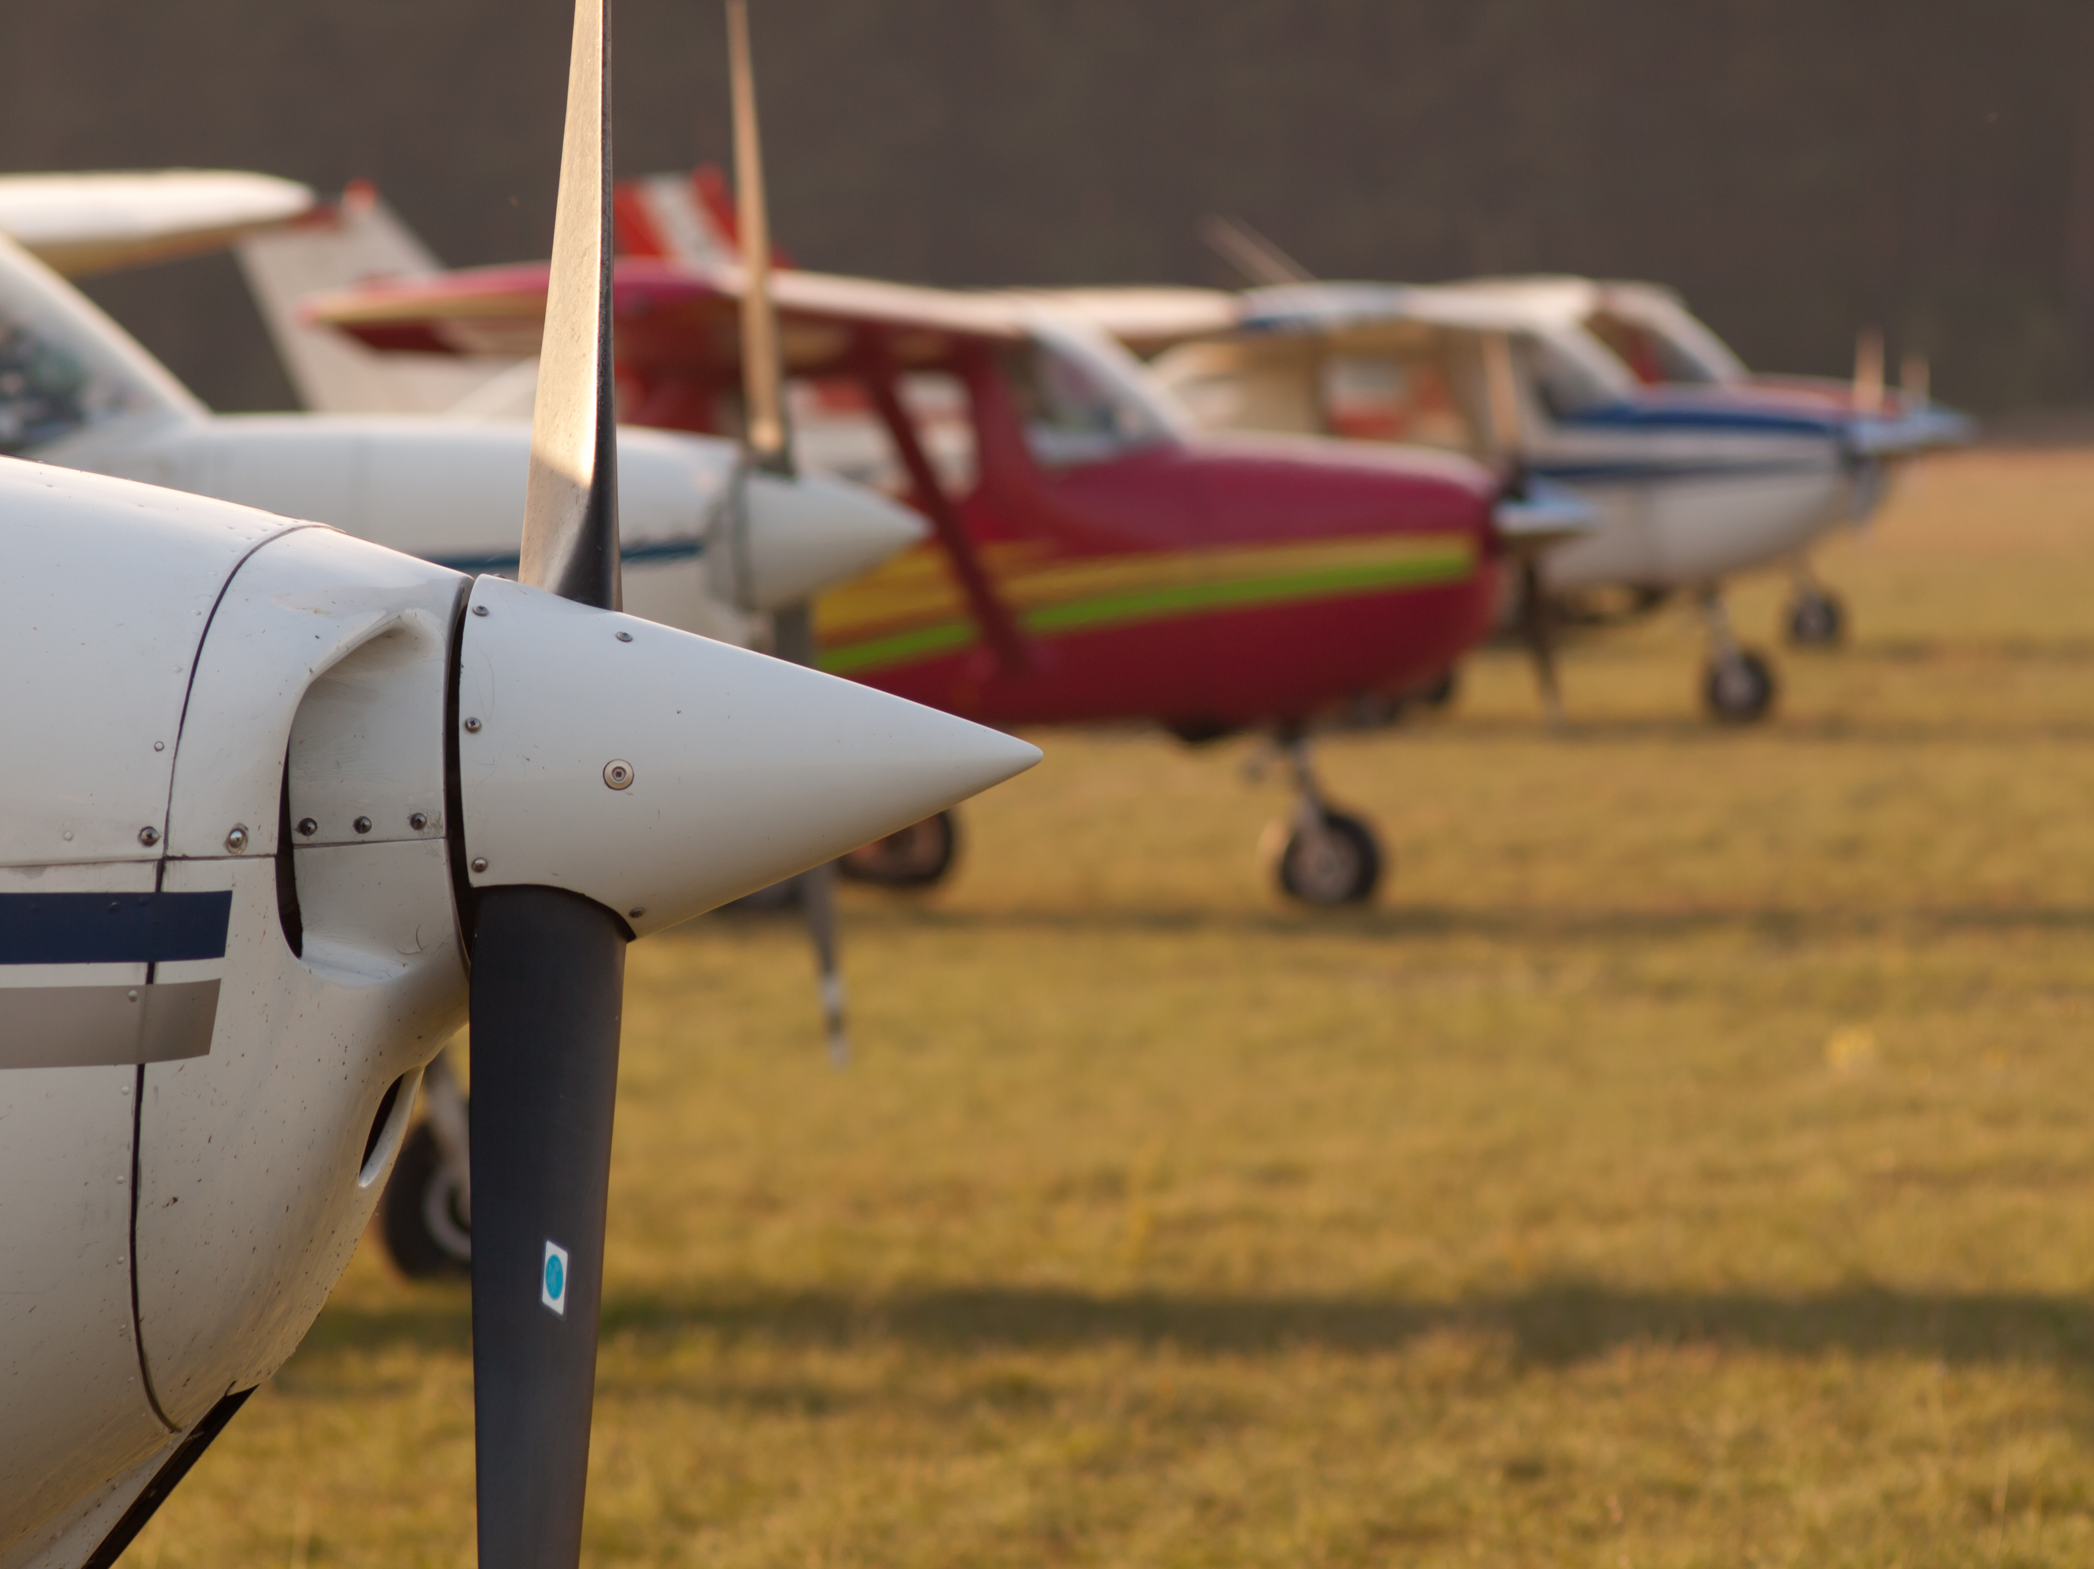
QUESTIONS?

Slide 18
www.raa.asn.au

