Slide 1
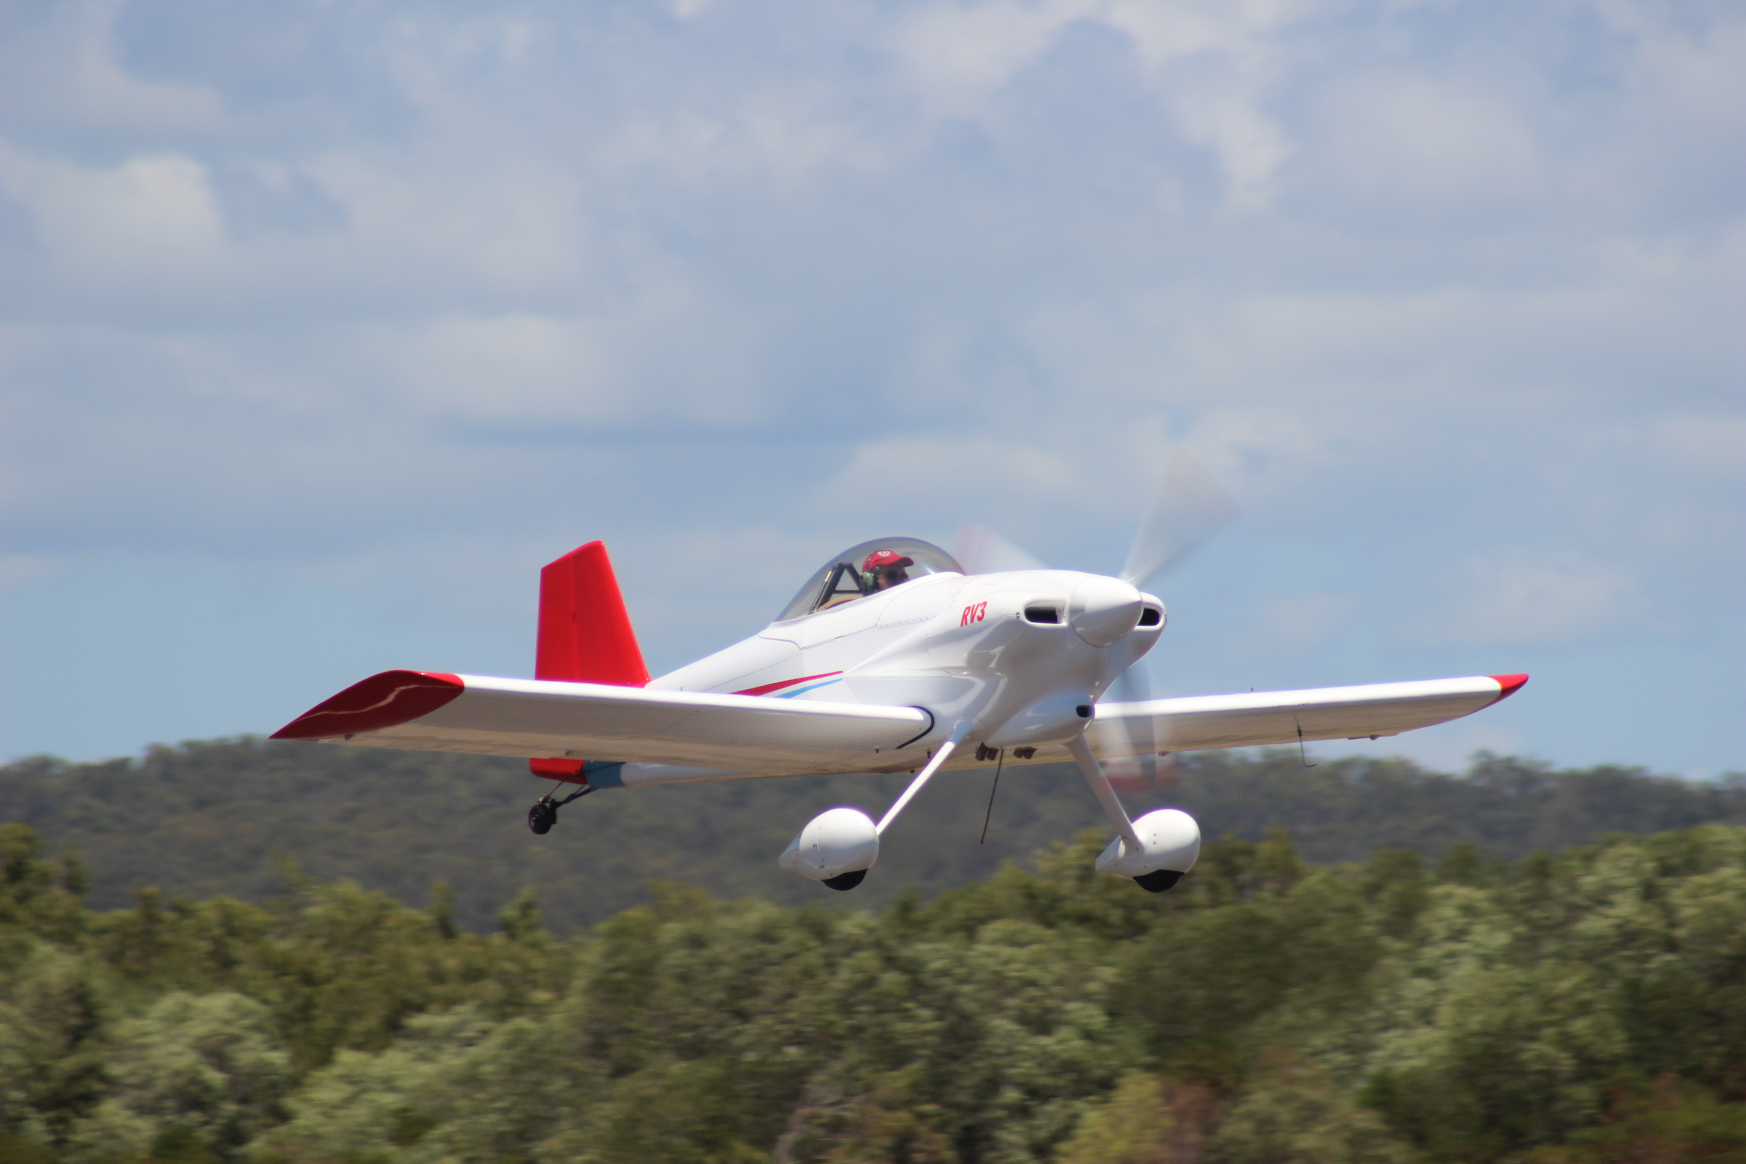

Slide 2
Forced Landings without power

Slide 3
AIM
For you to understand the possible causes of an engine failure and how to accurately carry out an emergency forced landing without power.

Slide 4
APPLICATION
At the end of this briefing you will by able, correctly and from memory, to:
State the initial actions to be taken in the event of a total engine failure.
List the trouble checks.
State the contents of a “mayday” radio call.

Slide 5
UNDERPINNING THEORY

Slide 6
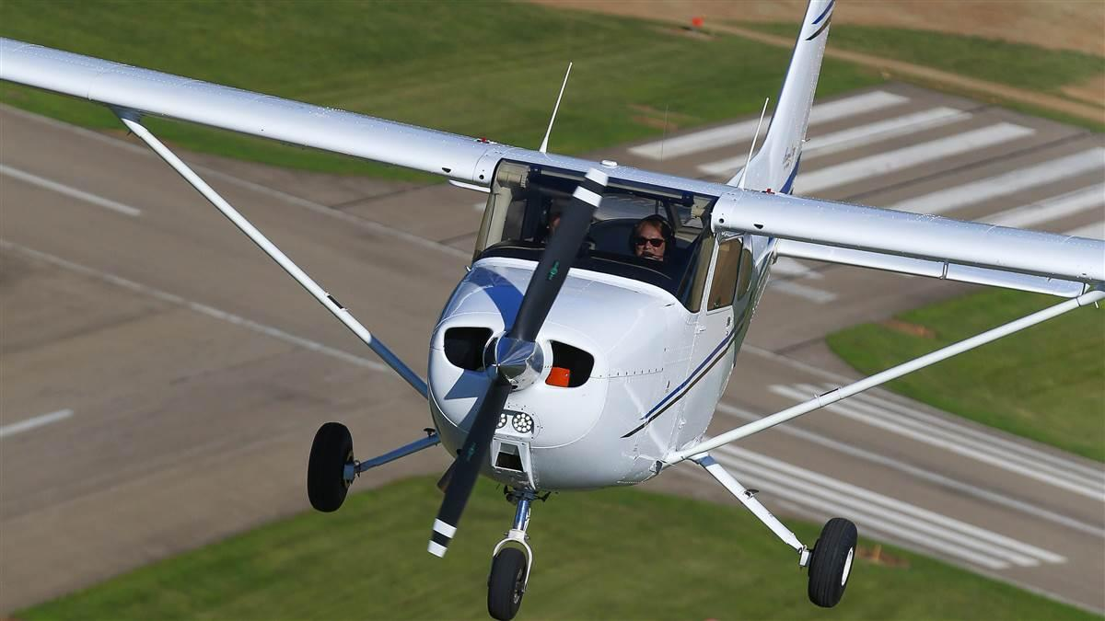
Possible Causes
Fuel starvation/exhaustion
Fuel contamination
Primer not locked in
Carburetor ice
Ignition failure
Mechanical failure
Oil loss
Propeller failure
Fire

Slide 7
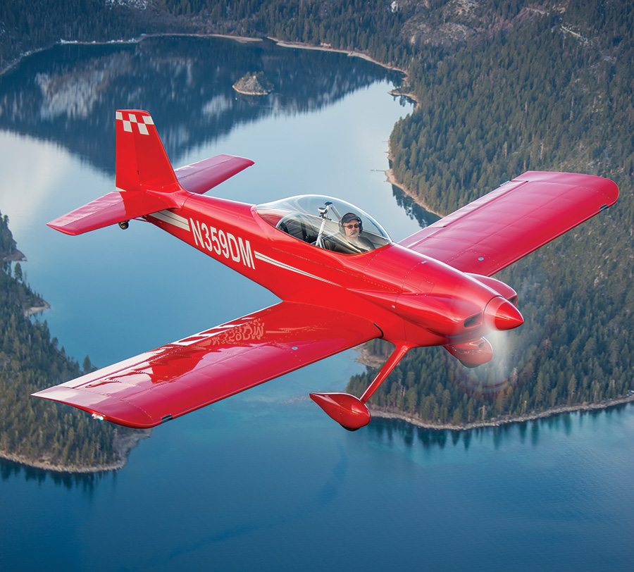
Most Forced landings are avoidable
Pre-flight planning
Fuel caps, fuel drains and fuel vents
Know your aircrafts’ performance
Pre take off checks
In flight fuel plan

Slide 8
Emergency Airspeeds
WHAT ARE THEY:
Engine Failure After Take-off:
Wing Flaps Up 70 KIAS
Wing Flaps Down 65 KIAS
Maximum Glide:
600Kg MTOW 70 KIAS
Precautionary Landing With Engine Power 65 KIAS
Landing Without Engine Power:
Wing Flaps Up 70 KIAS
Wing Flaps down 65 KIAS

Slide 9
Engine failure inflight Immediate actions
WHAT ARE THEY:
Fly the aircraft Airspeed 70 KIAS and Trim.
Carburettor Heat ON.
Fuel Selector Valve check on.
Mixture RICH.
Ignition Switch BOTH (or START if propeller is stopped)
choke IN.
Find somewhere to land.

Slide 10
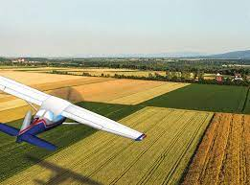
Field Selection
6Ss
Size
Shape
Surface
Slope
Surrounds
Safety

Slide 11
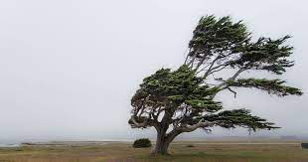
Wind Direction
Smoke
Dust
Ripples on a dam
Trees
Windmills
Cloud shadows
Area forecast
Last known wind

Slide 12
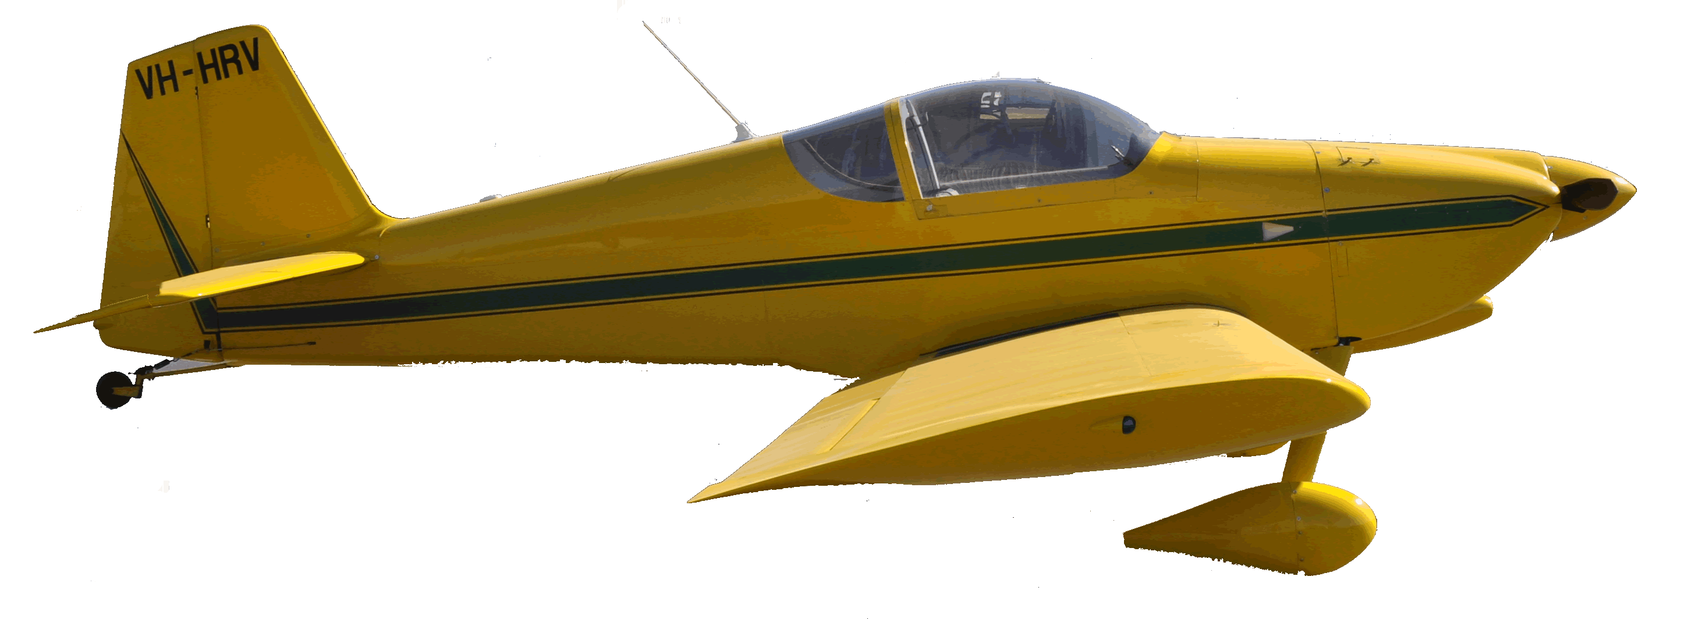
Make a Plan
ENGINE FAILURE ABOVE 3000 FT
ENGINE FAILURE BELOW 3000 FT
HI KEY 2500FT AGL
*
X
*
LOW KEY 1500 ft AGL
LOW KEY1500 ft AGL
BASE TURN 1000 ft AGL
BASE TURN 1000 ft AGL

Slide 13
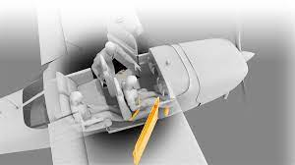
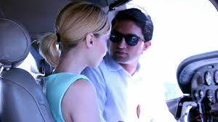
Passenger Briefing
Tell them what has happened
Where you are going
Reassure, i.e. “I want you to relax I’ve been trained for this.”
Ensure harnesses are secure
Show brace position
Explain again how hatches work
Remove glasses, sharp objects from pockets
Secure loose objects
Location of survival equipment and first aid kit
Actions after landing

Slide 14
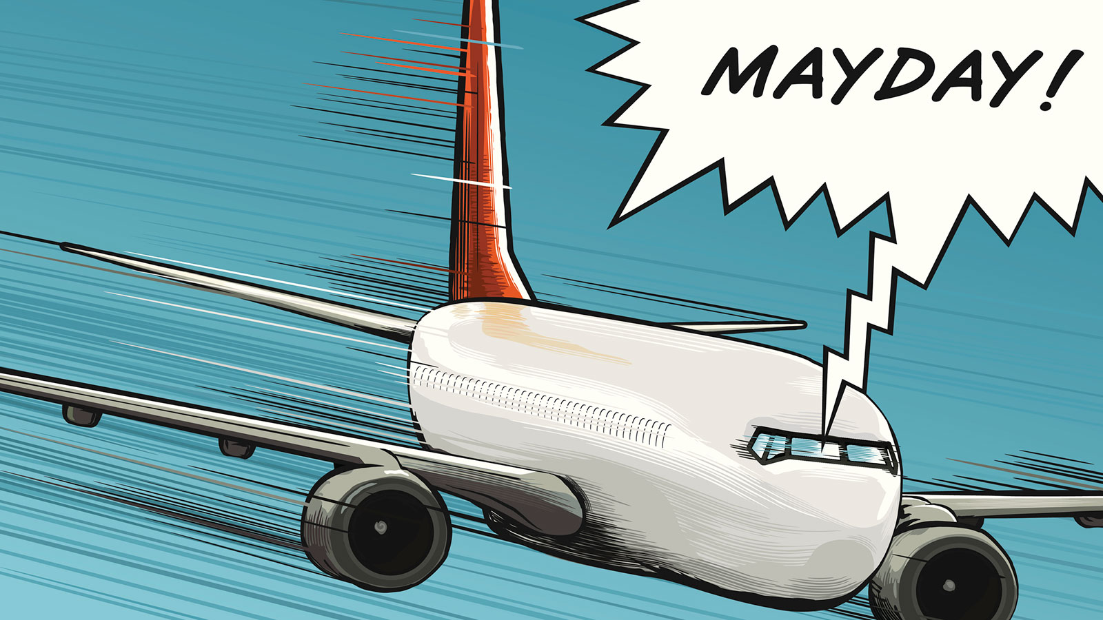
Mayday Call
Area Frequency
Mayday, Mayday, Mayday
Aircraft call sign (3 times)
Nature of distress
Position
Intentions
Number of people on board
Plus any other useful information
No dangerous Goods

Slide 15
Transponder

Slide 16
GLIDE APPROACH FROM DOWNWIND
*

Slide 17
WHAT IF WE’RE TOO HIGH?
Once we have selected a field we should not change from that field unless absolutely necessary.
Consider:
Full flap
Sideslip
“S” turns *

Slide 18
PUTTING IT TOGETHER
MAKE YOUR PLAN
BRIEF PASSENGERS
FLY THE AIRCRAFT
IMMEDIATE ACTIONS POH
ENGINE FAILURE ABOVE 3000 FT
HI KEY 2500FT AGL
MAYDAY CALL
*
LOW KEY 1500 ft AGL
X
BASE TURN 1000 ft AGL
SHORT FINAL SECURE THE AIRCRAFT
GLIDE APPROACH

Slide 19
Ditching
Aim to land along the swell, between the waves
Into wind if possible
If retractable undercarriage, gear up
Aim to touchdown slowest possible forward speed with high nose attitude
Put life jackets on before ditching:-
DO NOT INFLATE UNTIL CLEAR OF THE AIRCRAFT

Slide 20
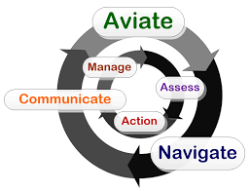
Airmanship
Aviate, navigate, communicate
Simulate MAYDAY call
Simulate transponder code
Do not fly lower than 500’ AGL solo
Fly neighbourly- Livestock & Houses
Warm engine every 1000’ *

Slide 21
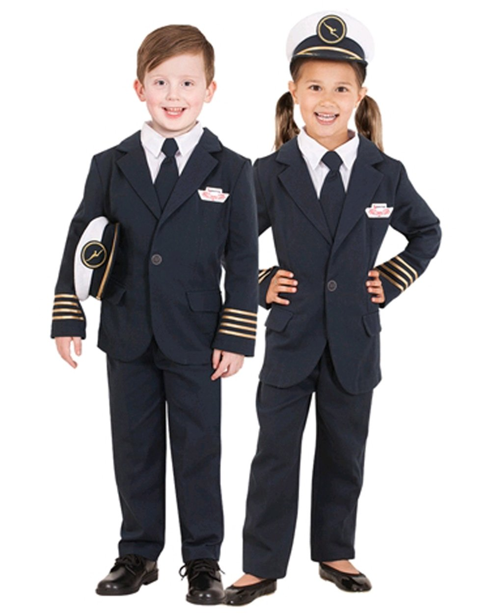
AIRMANSHIP AND HUMAN FACTORS
✓
Aviate, navigate, communicate
✓
Simulate MAYDAY call
✓
Simulate transponder code
✓
Do not fly lower than 500’ AGL solo
✓
Fly neighbourly- Livestock & Houses
✓
Warm engine every 1000’ *

Slide 22
OUTCOMES & EXPECTATIONS
State the initial actions to be taken in the event of a total engine failure.
List the trouble checks.
State the contents of a “mayday” radio call.

Slide 23
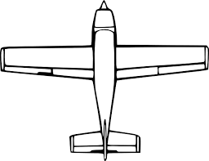
CROSSWIND BRIEF
AIRMENSHIP
CLOCK CODE
12
9
3
6

Slide 24
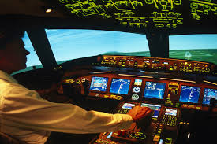
PRE SOLO BRIEF
AIRMENSHIP
IMSAFE
I - ILLNESS
M - MEDICATION
S - STRESS
A - ALCOHOL
F - FATIGUE
E - EATING & DRINKING

Slide 25
QUESTIONS?

Slide 26
www.raa.asn.au

